Slide 1
Model selection with SOC

Slide 2
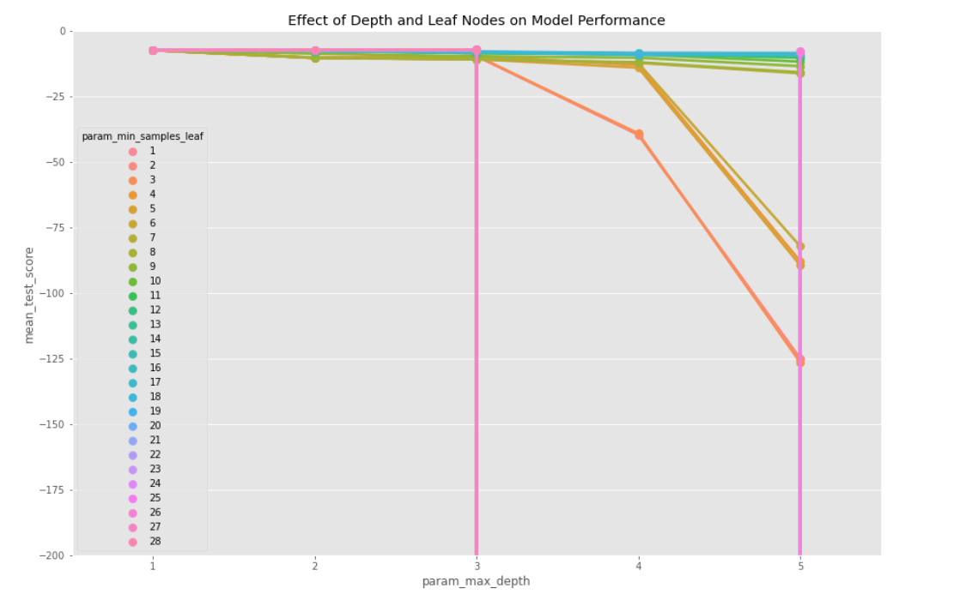

Auto MPG

Slide 3
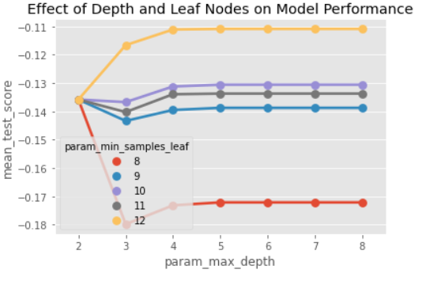
Servo

Slide 4
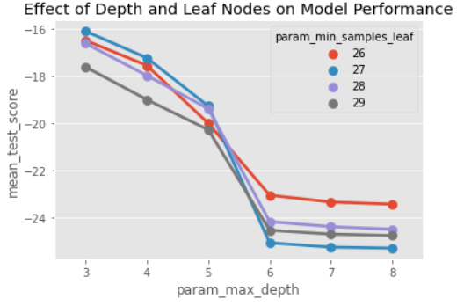
Forest Fire

